Slide 1

Team Hollywood
Minhui Gu, Alireza Louni, Aruna Cheruvu, Priyanka Kalangutkar

Slide 2

Goals of the project
Too much data of movies on the internet.
Spread around various websites.
Catered to general public.

Slide 3
Goals of the project
Website catered to specific users in the industry.
Information such as top grosser, most popular genre depicted.
Helps in future planning of movies

Slide 4
Sources Used
IMDB.com
rottentomatoes.com
YouTube.com

Slide 5
Production Houses Considered
Columbia
Paramount
Disney
Universal
MGM
Warner Bros.

Slide 6
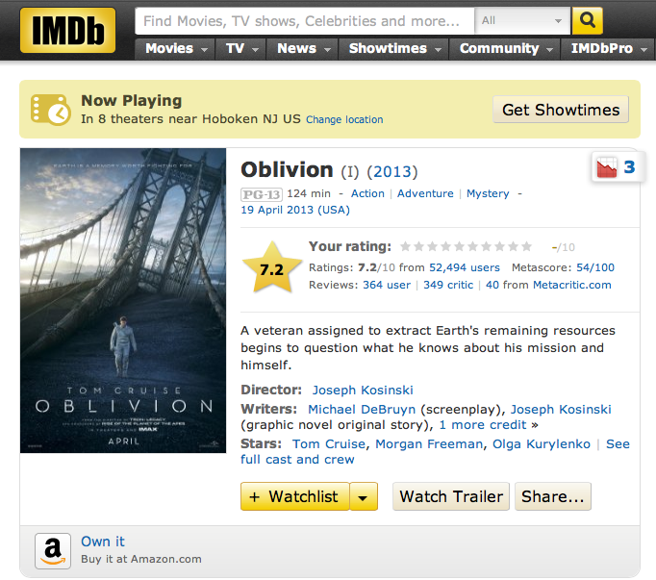

Slide 7
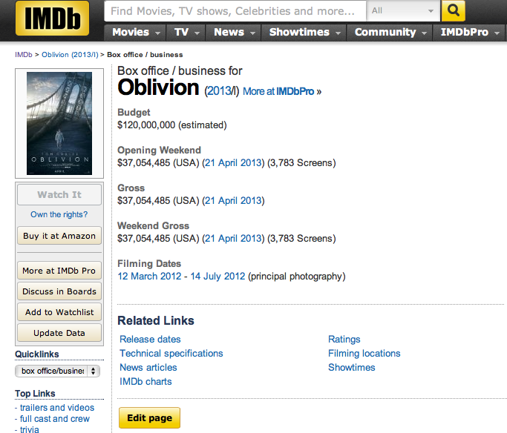

Slide 8
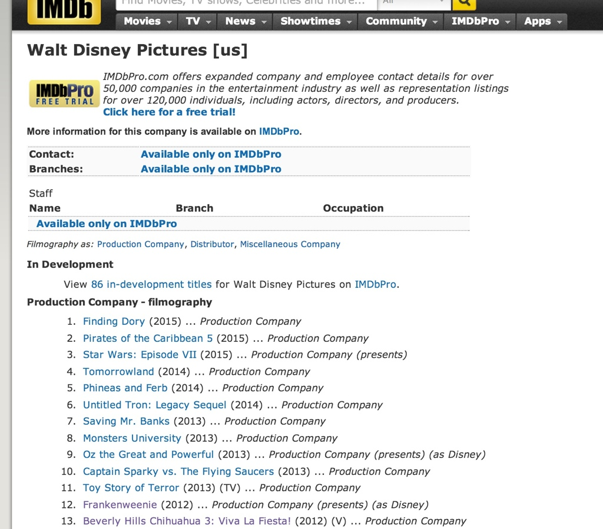

Slide 9
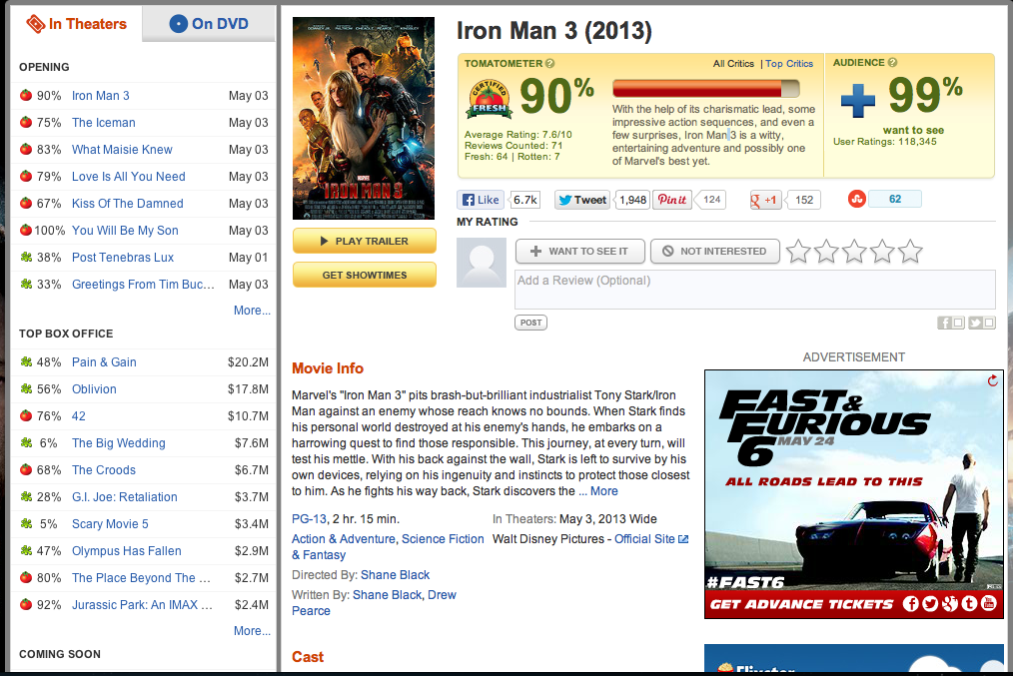

Slide 10
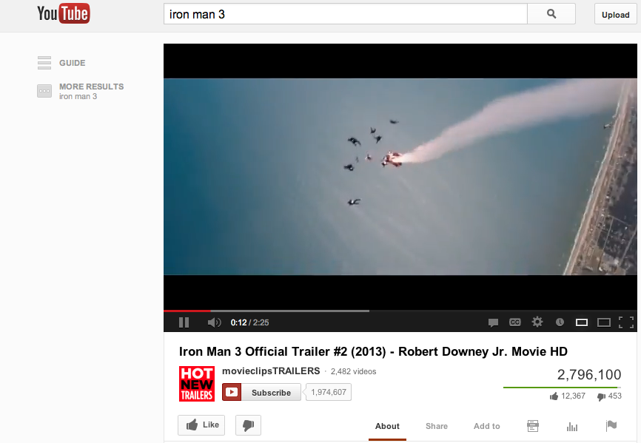

Slide 11
Website Demonstration

Slide 12
Conclusion
Hollywood : Multi Billion dollar industry.
Everyone wants to succeed.
Everyone wants to make money.
Use of analytics perfect way to maximize return on invested money.

